Slide 1
DOEHRS-HC Additional Functions 1
Tri-Service Hearing Technician
4.2 Certification Course

Slide 2
DOEHRS-HC Additional Functions 1 Learning Objectives
3.6.1 Understand how to apply for a DOEHRS-HC DR user account and to keep it active
3.6.2 Understand when and how to perform a lookup table update
3.6.3 Understand how to compact and repair the DOEHRS-HC database
3.6.4 Understand where and how to back-up the DOEHRS-HC database
3.6.5 Understand how to do a DOEHRS-HC DR export and review the status of those uploads
3.6.6 Understand how to do a manual DR inquire, or inquire multiple SSNs or individually via the application
3.6.7 Understand when and why to pull the Daily Report Log, Follow-up Testing List and Requiring Re-established Baseline list
Tri-Service Hearing Technician 4.2.0.0 Certification Course

Slide 3
DOEHRS-HC Additional Functions 1 DOEHRS-HC DR User Account Request
https://doehrswww.csd.disa.mil/doehrsdr/pub/AccountRequest_input.action
Ensure your CAC is in the work station; request the correct type of account (Hearing Conservation) and specific branch of service (USA, USAF, USN)
Request a DR user account at least 1 week prior to performing any audio testing
Tri-Service Hearing Technician 4.2.0.0 Certification Course

Slide 4
DOEHRS-HC Additional Functions 1 DOEHRS-HC DR User Account Request
DOEHRS DR User name will be issued from your name, normally last name, first initial, middle initial, then a number if that user name is already in use. Name, SSN is confirmed with your CAC certificates.
Tri-Service Hearing Technician 4.2.0.0 Certification Course

Slide 5
Address = Booth location physical address
Your .mil email address
DOEHRS-HC certification number
ISSO (IT) .mil email address
Professional Supervisors or Senior Audio Technician .mil email address

Slide 6
DOEHRS-HC Additional Functions 1 DOEHRS-HC DR User Account Request
Select the first justification in the drop down window
If additional access is required contact NMCPHC
Press submit only once
Tri-Service Hearing Technician 4.2.0.0 Certification Course

Slide 7
DOEHRS-HC Additional Functions 1 DOEHRS-HC DR User Account Request
Once submitted a window will appear that states the DOEHRS DR received your account request and it will be processed by your Functional Representatives. You will receive an email to the email address associated with your application with your DR user name and a URL to go to link your CAC with your DR user account
Direct access to your DR user account is required at least once every 60 days to authorize your continued access
Tri-Service Hearing Technician 4.2.0.0 Certification Course
Notes:
Failure to access DR account directly will prohibit access to the DR via the DOEHRS-HC application

Slide 8
DOEHRS-HC Additional Functions 1 DOEHRS-HC Lookup Table Update
Every drop down window or additional pop-up window (examples: DoD/SVR Comp, Rank/Grade, SDOC, MACOM, etc.) has tables associated with it
These tables are updated at the Data Repository (DR) and are available the first workday of the every month (Eastern Standard Time)
They can be processed either via an internet connected DOEHRS-HC work station or downloaded from the Data Repository from an internet connected computer and transferred to a disc for a local update
Tri-Service Hearing Technician 4.2.0.0 Certification Course

Slide 9
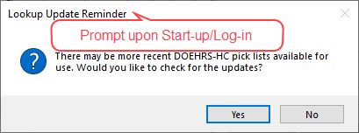
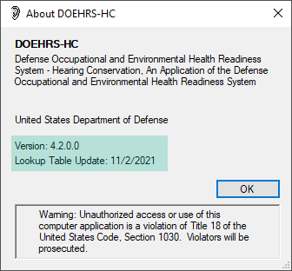
DOEHRS-HC Additional Functions 1 Version/Lookup Table Update
Tri-Service Hearing Technician 4.2 Certification Course Video Next Slide

Slide 10
Notes:
1 minute update video

Slide 11
DOEHRS-HC Additional Functions 1 Compact/Repair or Back-up Database
Compact and Repair or Back-up Database once completed performs a back-up of the database that is placed in the Back-up folder on the C Drive
Contains: Users, examiners, audiometers, calibration listeners, DD Form 2217, DD Form 2215, DD Form 2216, NHC tests and Referrals
Current only to the time it was created
Time for the compact and repair or Back-up depends on the size of the local database, the smaller it is, the faster it repairs and compresses
Back-up database should occur daily
Compact and Repair should be accomplished once a week
Always copy and/or move the back-up to a shared drive or external device to prevent data loss in case of a computer crash
Tri-Service Hearing Technician 4.2 Certification Course Video Next Slide

Slide 12
Notes:
1 minute compact and repair video

Slide 13
DOEHRS-HC Additional Functions 1 DOEHRS-HC DR Export
A DR export includes all newly created records and any previous records that were edited/saved
Creates an .MDB file, .TXT file and a .ZIP file (ZIP file is uploaded)
The application will securely connect with the data repository while it compacts and creates a zip file to export to the DR
If at any time this secure connections is disrupted, even for a millisecond the records may not be transmitted
Always verify the file made it to the data repository and was successfully processed
Non-internet connected DOEHRS-HC work stations will need to do a DR export to a local file and manually load that file to the DR
Next DOEHRS-HC Log-in, the application will ask if the upload was successful
Tri-Service Hearing Technician 4.2 Certification Course Video Next Slide

Slide 14
Notes:
25 second export video

Slide 15
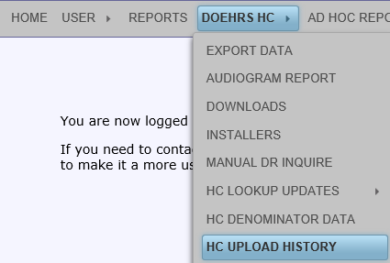
DOEHRS-HC Additional Functions 1 DOEHRS-HC Export Upload History
Verify export file was received
Ensure it was successfully processed
Manually re-export if the file was not received or unsuccessful
Bring to HCPM attentions any export issues
Tri-Service Hearing Technician 4.2.0.0 Certification Course
Notes:
Other than successful processing status requires the export be brought to the HCPM attention for assistance

Slide 16
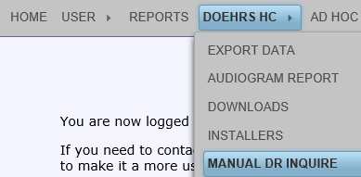
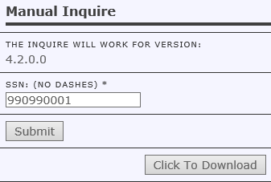
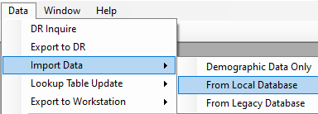
DOEHRS-HC Additional Functions 1 Manual DOEHRS-HC DR Inquire
Manual DR inquire for those sites that are not connected to the internet
Log into the DR, request records
Download file
Import file into local database
Tri-Service Hearing Technician 4.2.0.0 Certification Course

Slide 17
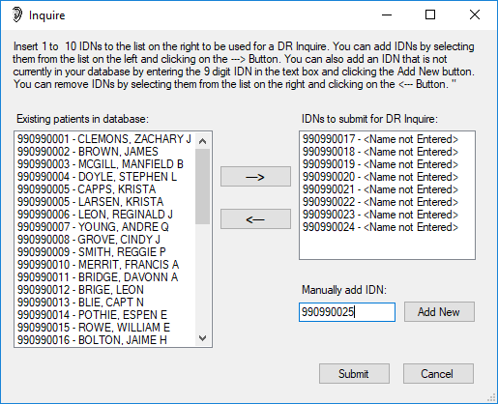
DOEHRS-HC Additional Functions 1 DOEHRS-HC DR Inquire, Individual or Multiple SSNs
DOEHRS-HC application can inquire up to 10 SSNs at a time
Enter SSN in the run test window (individual)
DR Inquire function can inquire multiple SSNs
Press Add New
Once all SSNs are entered, press Submit
Query will return records for those SSNs
Tri-Service Hearing Technician 4.2.0.0 Certification Course
Notes:
Multi-SSN Inquire could be done with known DR downtime or non-internet connected sites to pull down command population (Alfa roster)

Slide 18
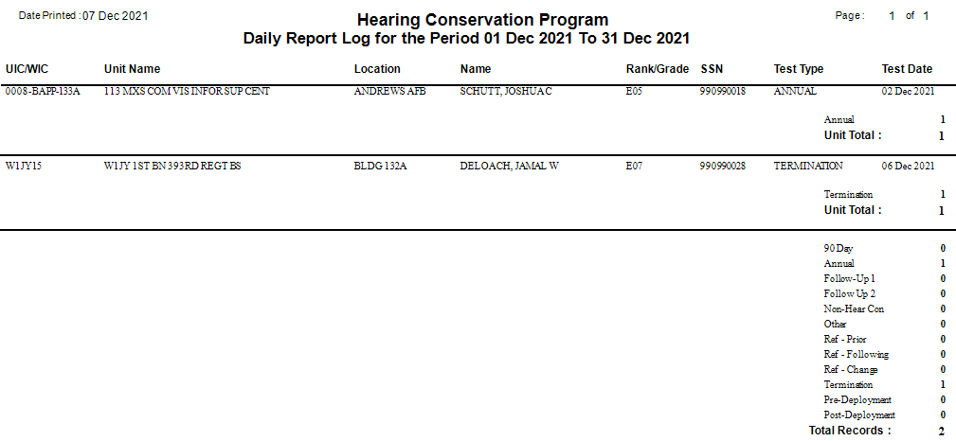
DOEHRS-HC Additional Functions 1 DOEHRS-HC Daily Report Log
Notes:
Briefly review the Daily Report Log, pull daily

Slide 19
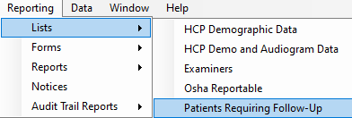
DOEHRS-HC Additional Functions 1 DOEHRS-HC Patients Requiring Follow-up Testing List
Patients who don’t return are removed from this list after 30 days
Pull list weekly
Conduct DR inquire on patients SSNs
Re-pull the list
Call patients to remind them to return for follow-up testing and to be 14 hours hazardous noise-free.
Notes:
Briefly review Patients requiring follow-up testing list, technician should pull this list weekly, do a DR inquire on the patients SSNs on the list, re-pull the list, and those that tested at another site will come off, call patients to remind them to return for follow-up testing and to be 14 hours hazardous noise-free.

Slide 20
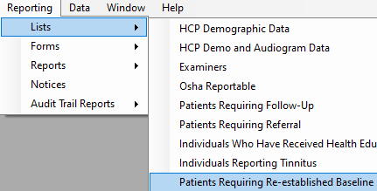
DOEHRS-HC Additional Functions 1 DOEHRS-HC Patients Requiring Re-established Baseline List
Contains only Positive STS on Follow-up 2 tests
Pull list weekly
Conduct DR inquire on patients’ SSNs
Re-pull the list
Call HCPM
Administratively re-establish baseline
Patient needs to return for evaluation
Notes:
Briefly review Patients requiring Re-established baseline list, technician should pull this list weekly, do a DR inquire on the patients’ SSNs on the list, re-pull the list, and those whose baseline was re-established will come off, check/call audiologist schedule/audiologist to either administratively re-establish the baseline or requiring calling patients to make an evaluation appointment.

Slide 21
DOEHRS-HC Additional Functions 1 Summary
Procedures to applying and keeping active a DOEHRS-HC DR user account
Perform a lookup table update
Compact and repair the DOEHRS-HC database
Back-up the DOEHRS-HC database
Conduct DOEHRS-HC DR exports and review their status
Manual DR inquire
Application inquire for multiple SSNs or individually
Daily Report Log
Follow-up Testing and Requiring Re-established Baseline lists
Tri-Service Hearing Technician 4.2.0.0 Certification Course

Slide 22
DOEHRS-HC Additional Functions 1
? Questions ?
Tri-Service Hearing Technician
4.2 Certification Course

